Slide 1
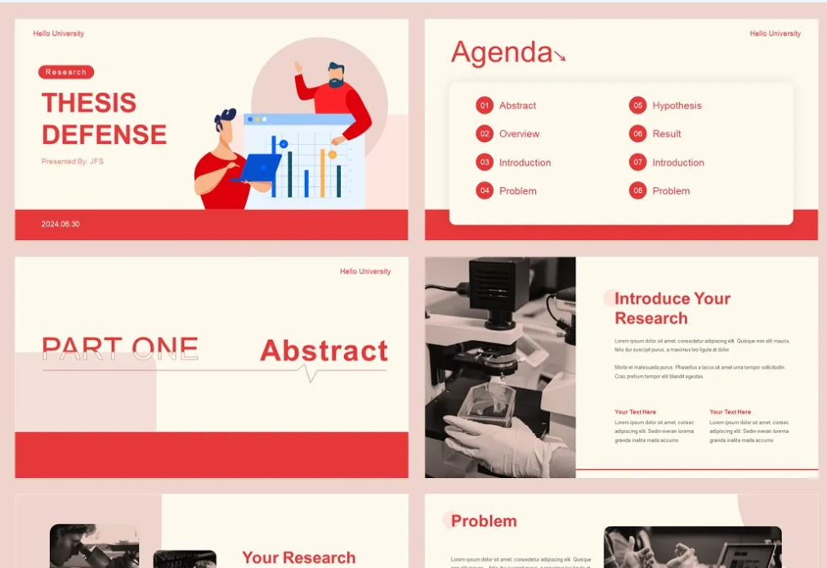
RoboWriter: A UR5e-Based Calligraphy Robot for Multi-Format Writing with Adaptive Trajectory Planning
Abyss
this is the first Korean empirical case study on the reurbanization pattern of manufacturing.
Therefore, the results of this study can be added to the literature on urban manufacturing and urban production as an Asian research case.
team members: 穆昊炎 2025531094
team ID:04 刘立禾 2025533119
张嵇云 2025591010
Abyssal Hunters

Slide 2
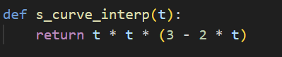
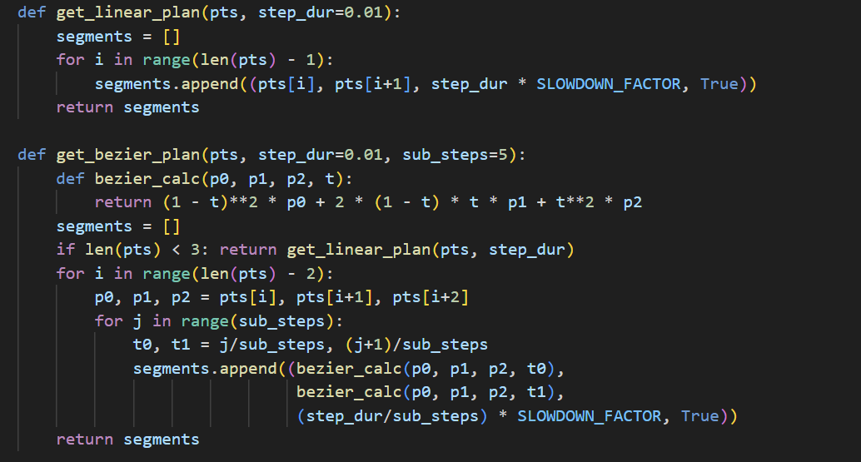
01
different interpolation methods
Cubic Hermite Interpolation
Linear Interpolation
Quadratic Bézier Curves

Slide 3
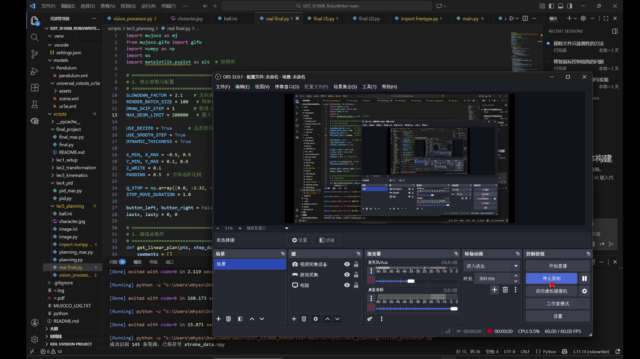
01
Basic+Bonus
The final

Slide 4
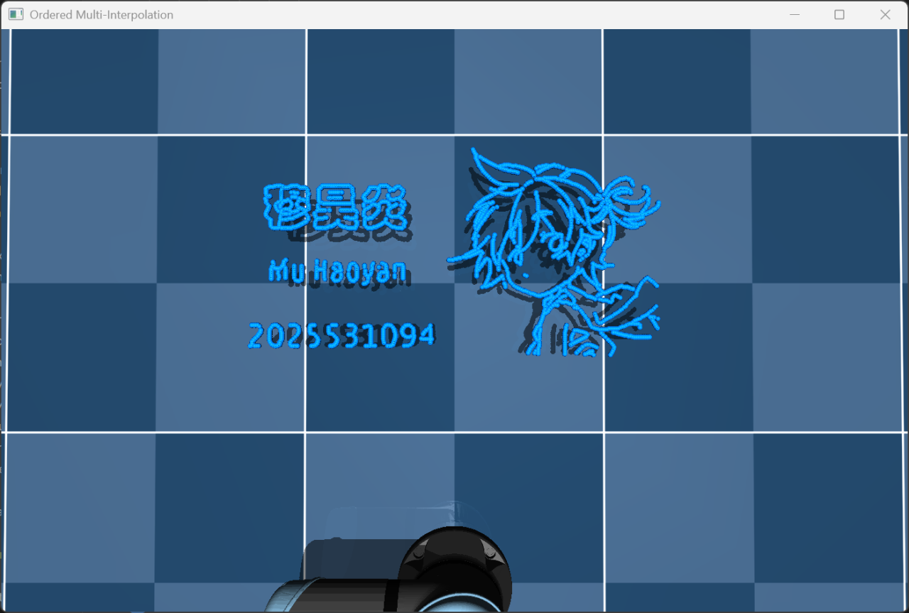
01
Result of the Basic

Slide 5
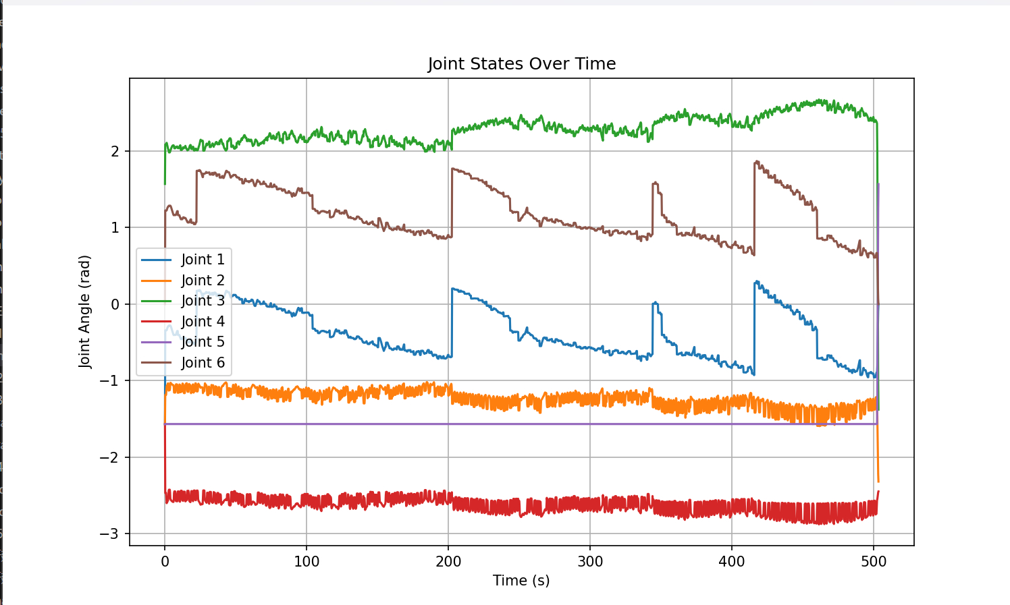
01
Basic
The plot

Slide 6

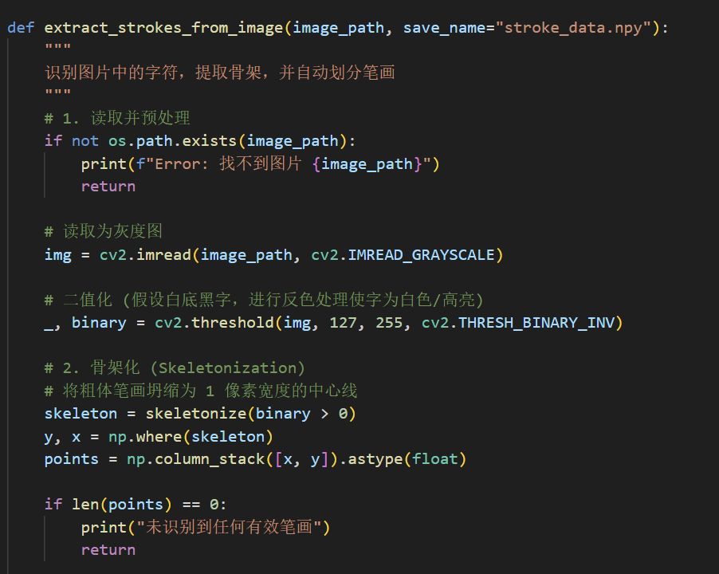
02
Innovation Points
This script processes images using skeletonization and topology analysis to extract the central one-pixel-wide path of characters or shapes. It then segments these paths into distinct strokes and normalizes the coordinates, saving the result as a trajectory data file for robotic writing applications.

Slide 7
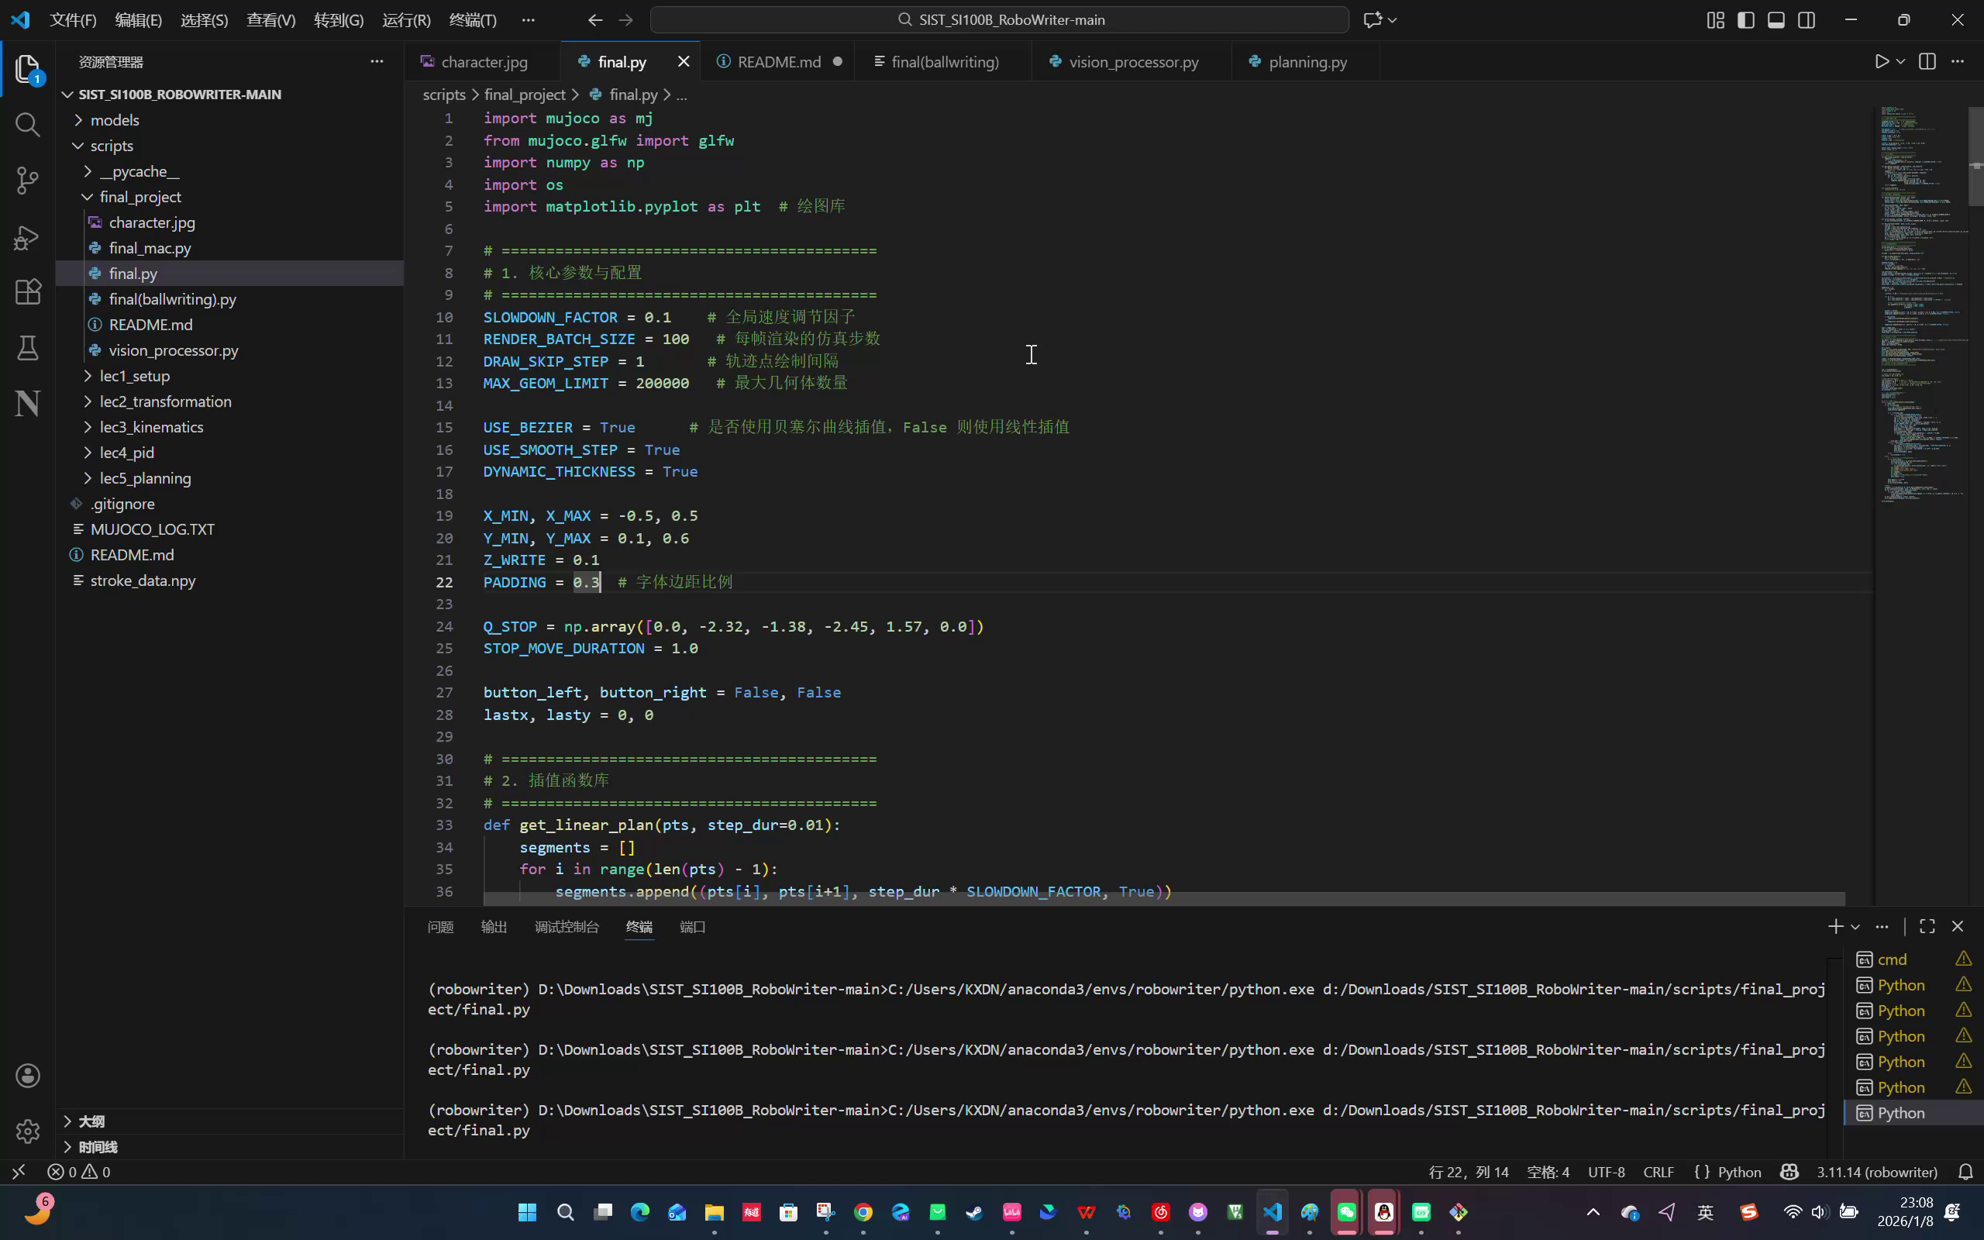
02
Bonus

Slide 8
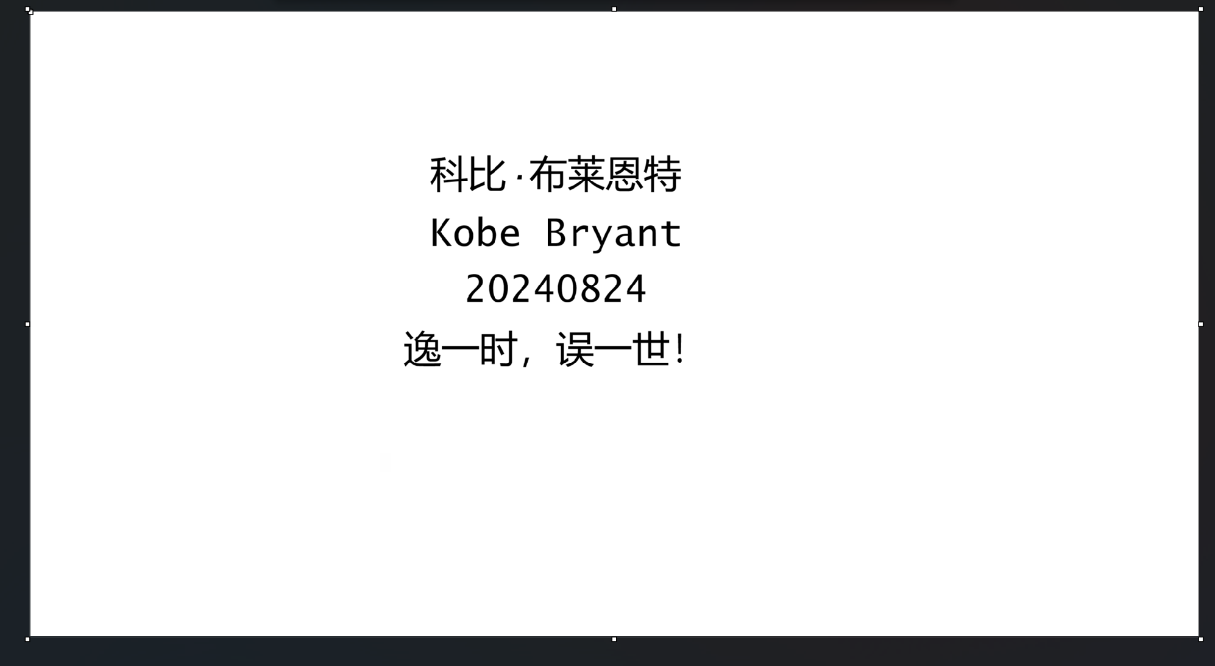
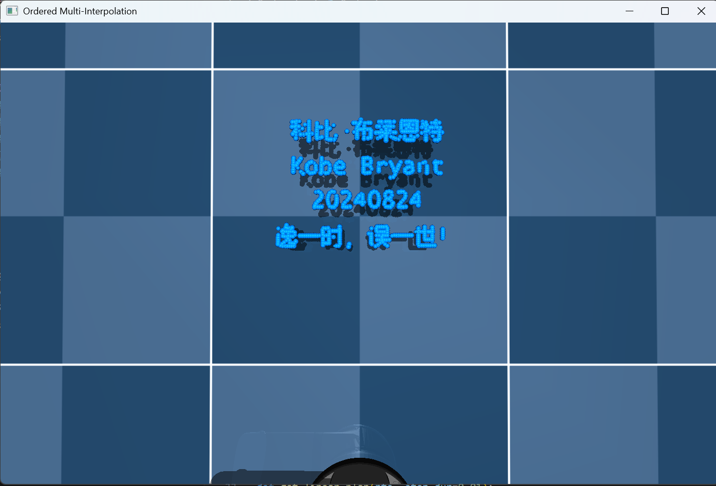
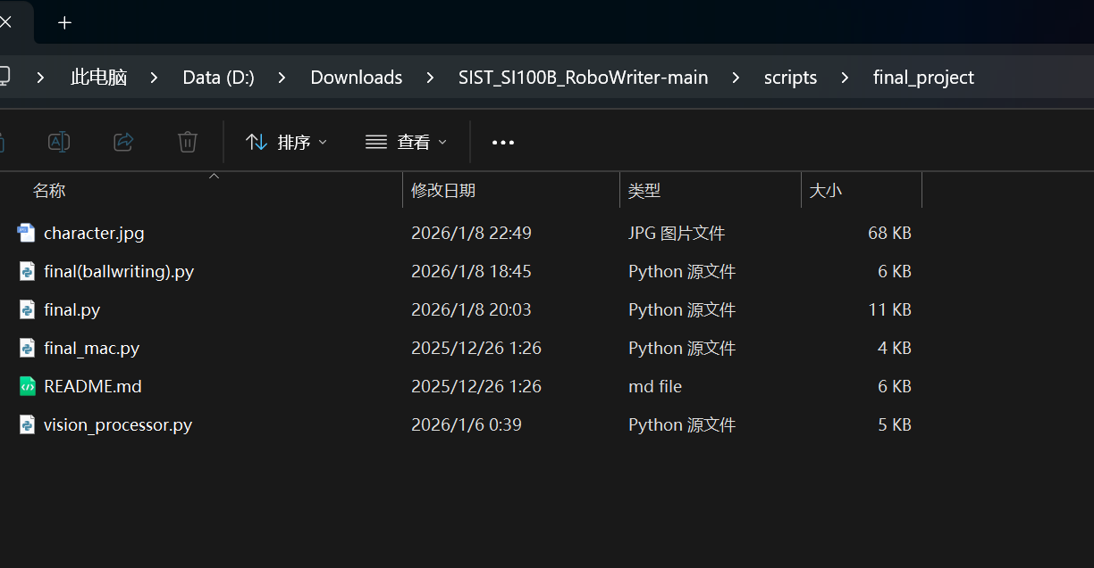
02
Result of the Bonus
-------------->>>>>

Slide 9
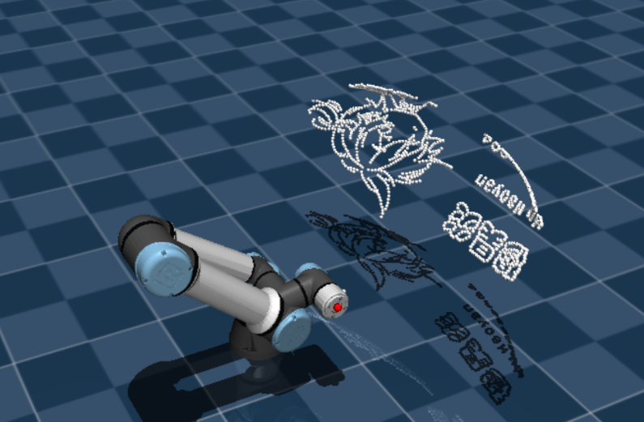
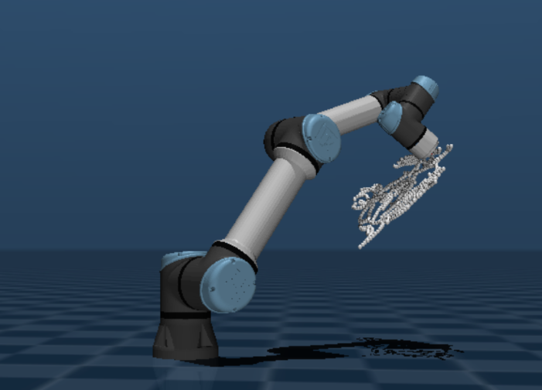
02
Bonus
Drawing on curved surfaces

Slide 10
03
Limitations
· Naive Stroke Ordering Logic
· Artifacts in Skeletonization & Segmentation
· Absence of Force Feedback Control

Slide 11
04
Futrue work
Future research will focus on integrating Deep Learning models to predict authentic stroke sequences, ensuring the writing process aligns with traditional calligraphic standards. Furthermore, implementing a Hybrid Force/Position Control strategy will allow the robot to adjust its pressing depth dynamically, achieving more natural ink effects. Lastly, we aim to optimize the Trajectory Planning algorithms to handle singular configurations effectively, enhancing the system's robustness during complex character rendering

Slide 12

Thank you

